Slide 1
CST8117 Cross Platform Web Design
Assignment 1
The Style Guide

Slide 2
The Style Guide
Welcome to the bittersweet cafe

Slide 3
The Client of Website
Design and build Bittersweet Café website.
The target customer is
Teenage,
and The new comer from Hong Kong
Let customer enjoy the bitter and the sweet from coffee
Friends and Family make this house a home

Slide 4
The Style
Describe the kind of feeling or story that your design is meant to convey to the visitor

Slide 5
1. Typography
Font: “Marck Script”
Font size: 50px
Font Weight: Bold
Color: #775a0e
Bittersweet Cafe

Slide 6

2. Logotypes
Size: width100px

Slide 7
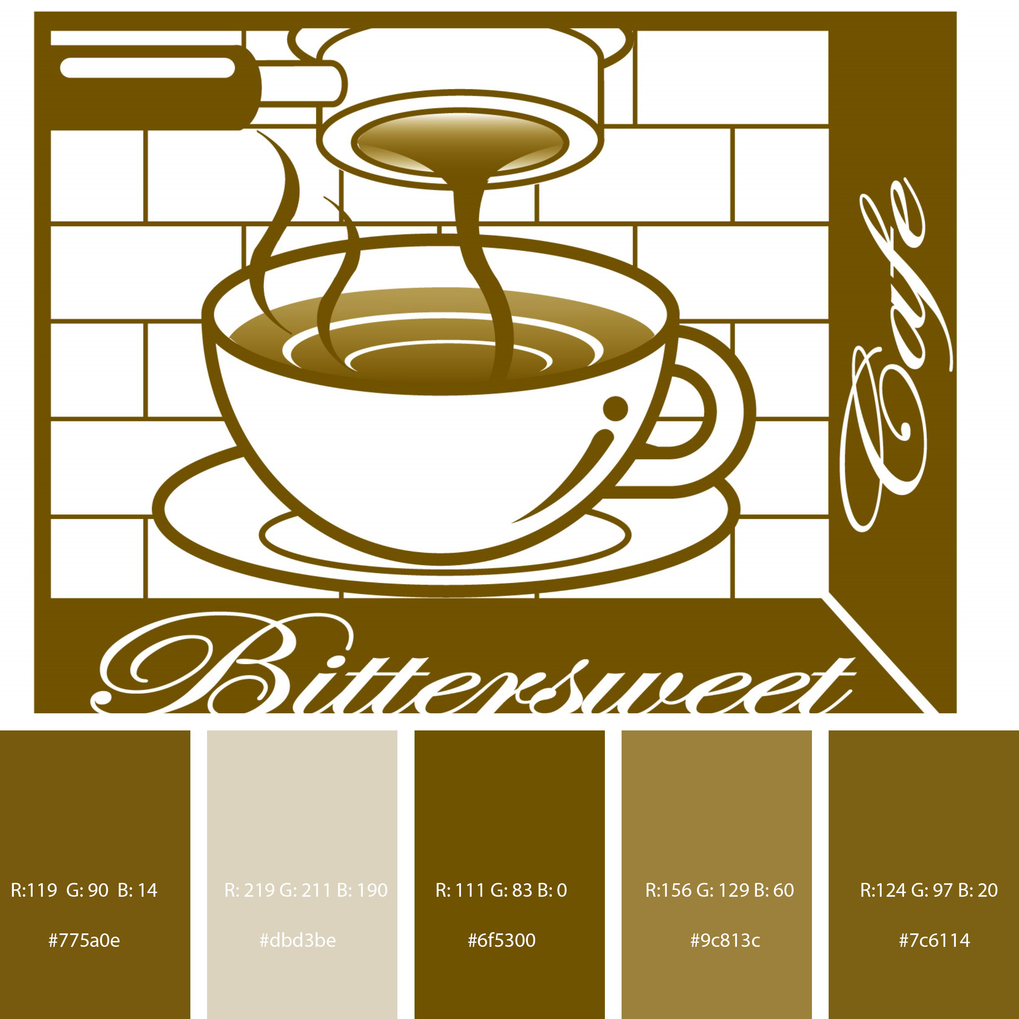
3. Color palette

Slide 8
3. Color palette
#6f5300
#775a0e
#7c6114
#9c813c
#dbd3be
#fff

Slide 9
3. Color palette
Form content color
Menu table head Background Color
Header
Footer
Bittersweet
Form title color
Menu table color
Contact font color
Carousel slide background color
Content
Carousel slide background color
Form Background Color
Menu table Background Color
Menu table head Color
Coffee and cake background color
#6f5300
#775a0e
#7c6114
#9c813c
#dbd3be
#fff

Slide 10
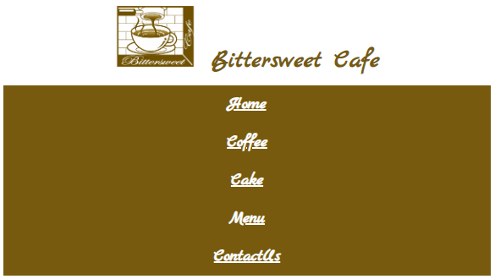
4. Platform - Responsive layout
Responsive layout rules
Nav in small mobile (30px)
Nav in large monitors (50px)

Slide 11
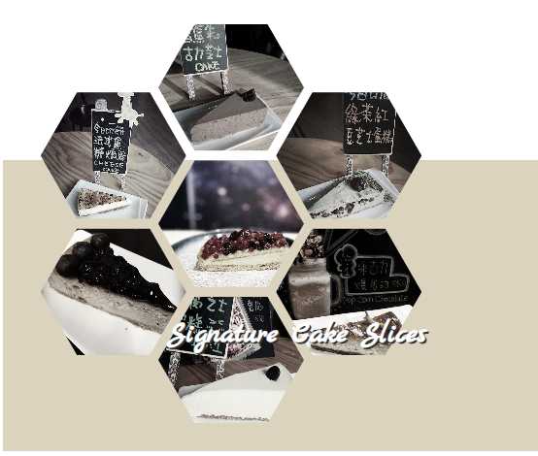
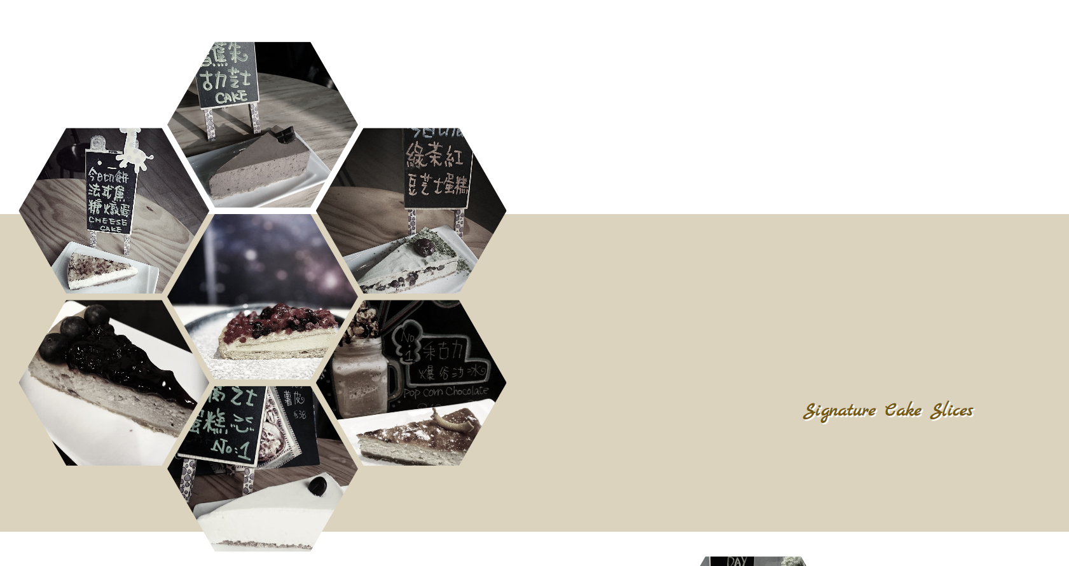
4. Platform - Responsive layout
div (signature) in small mobile
(Height: 300px, Size: 150px)
Responsive layout rules
div (signature) in large monitors
(Height: 500px, Size: 300px)

Slide 12
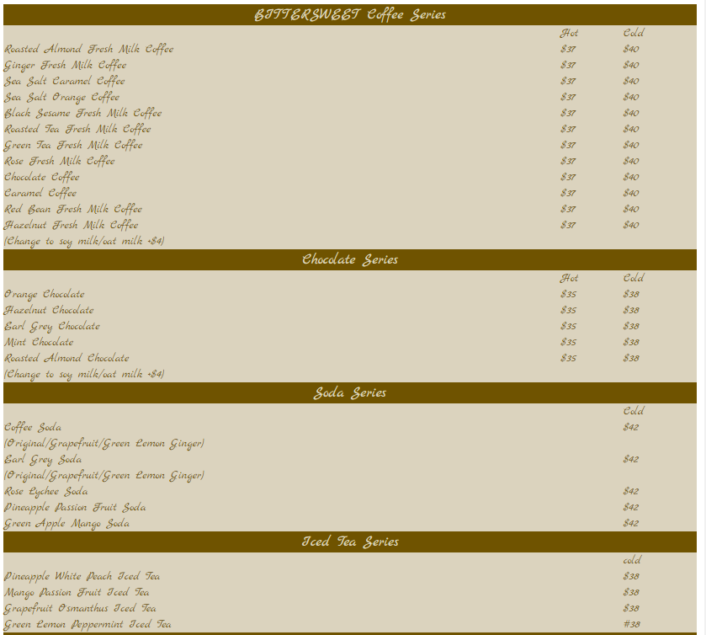
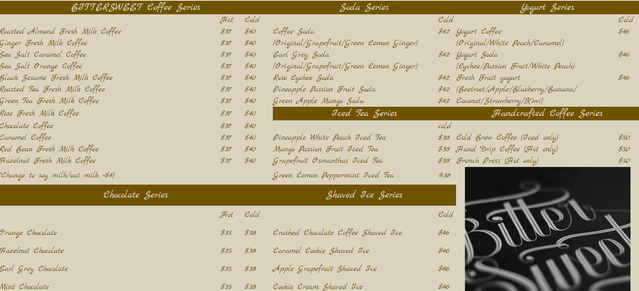
4. Platform - Responsive layout
Responsive layout rules
Menu table in small mobile
Menu table in large monitors

Slide 13
5. Semantic design guide
Index page – signature div design guide
div signature background color sequence
#dbd3be
#9c813c
div signature font color sequence
#775a0e
With white shadow (2px)
#fff
With grey shadow #333

Slide 14
5. Semantic design guide
Header design guide
header {
text-align: center;
font-family: 'Marck Script';
font-weight: bold;
font-size: 50px;
box-shadow: grey;
color: #775a0e;
}
@media screen and (max-width:760px) {
header {
text-align: center;
font-family: 'Marck Script';
font-weight: bold;
font-size: 30px;
box-shadow: grey;
color: #775a0e;
}

Slide 15
5. Semantic design guide
Nav design guide
.navbar {
display: flex;
flex-direction: row;
justify-content: space-evenly;
}
.navbar a:hover{
margin: 10px;
font-family: 'Marck Script';
font-size: 20px;
color:black;
background-color: white;
cursor: pointer;
}
.navbar, .navbar a{
margin: 10px;
font-family: 'Marck Script';
font-size: 20px;
color: white;
background-color: #775a0e;
}

Slide 16
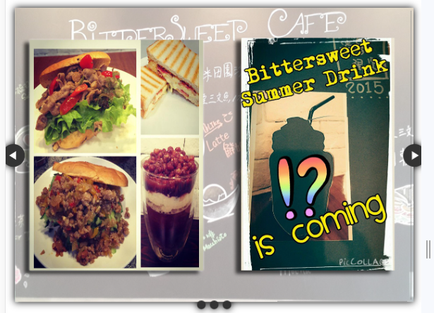
5. Semantic design guide
Main section include carousel design guide

Slide 17
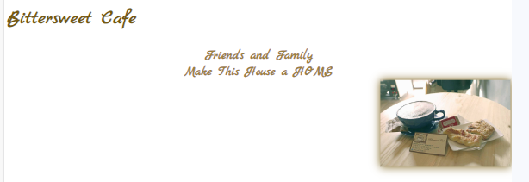
5. Semantic design guide
Main section include bittersweet keyslogan design guide

Slide 18
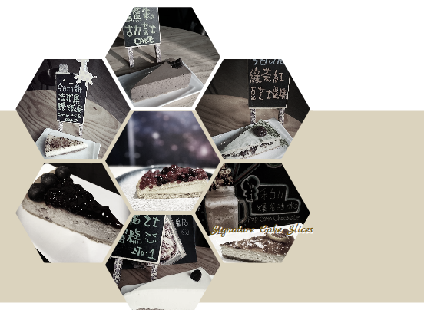
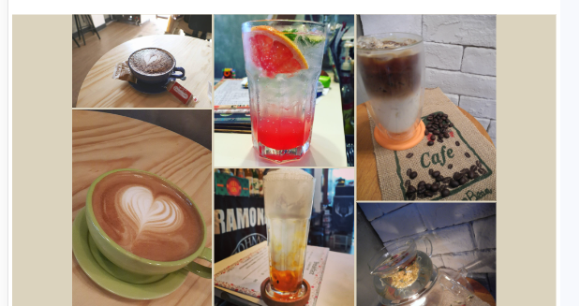
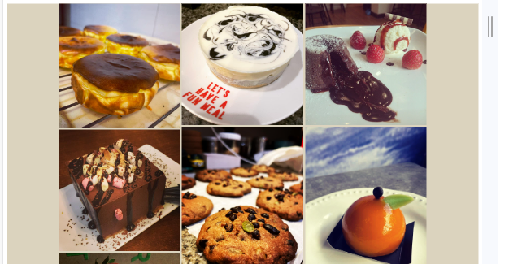
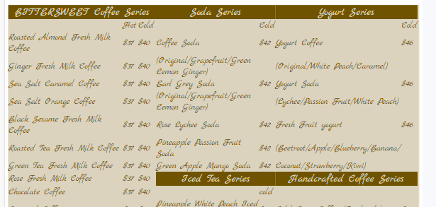
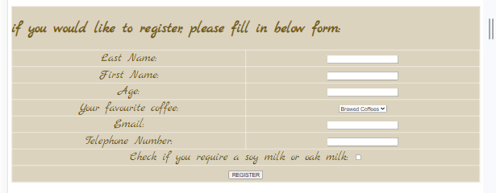
5. Semantic design guide
Main section
Index page include signature design guide
Coffee page include gallery of coffee design guide
Cake page include gallery of cake design guide
Menu page include menu design guide
Contact us page include form and address

Slide 19
5. Semantic design guide
footer design guide
footer, footer a {
background-color: #775a0e;
color: white;
font-family: 'Marck Script';
font-size: 20px;
text-align: right;
}
footer img {
height: 30px;
padding-right: 10px;
float: left;
}
.linkfooter {
text-align: left;
color: white;
height: 40px;
}

Slide 20
6. Website Map
Homepage
Booking
Cake
Menu
Contact Us
Coffee
Signature Cake Slices
Signature Toast
Signature Coffee
Signature Summer Drinks
Forms
Address and Email
Gallery of Coffee
Gallery of Cake

